Slide 1
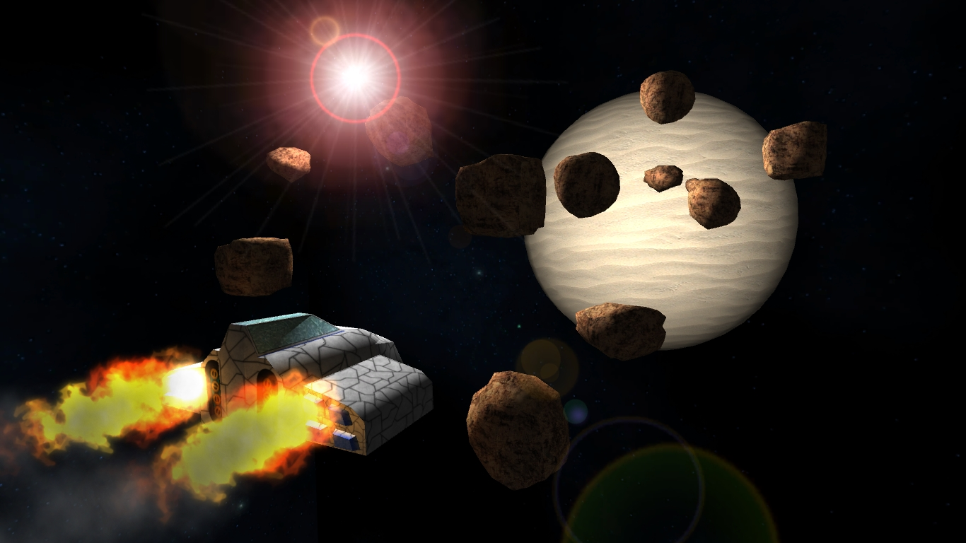
Traders of the Border Worlds
By Quantum Granite

Slide 2

Who?
Nimrod Libman – Game Engine,Art
Ross Kelso – Commerce System
Cameron Barker – Web Design,Art
Lazar Milosevic – Web Design

Slide 3
What?
A fictional trading game, similar to “Elite” set in space, with prices based on open data.

Slide 4
How?
Yahoo! Finance
Yahoo! Pipes
The Game
CSV
JSON
HTML 5 <canvas> tag
JavaScript
CSS

Slide 5
Why?
To explorer the ways that economies and trading work
To expand our knowledge and understanding of web based technologies

Slide 6
What Next?

